Slide 1
FINISHING GAMES (and slaying monsters)
A presentation by Woodsy Studio

Slide 2
Obstacles
There are always practical concerns…
Budget
Missing assets
Bugs, etc.
But usually, your biggest enemy is YOURSELF
Scope Creep
“I need to add more features”
Dispassion
“I’m not excited about this anymore”
Perfectionism
“My game isn’t good enough”

Slide 3
GAME JAMS!
These are the best practice for finishing games!

Slide 4
Game Jam Example

Slide 5
SLAYING Scope Creep
“I NEED TO ADD MORE FEATURES”

Slide 6
Set a deadline (AND Stick to it!)
If your project is small and short… set a deadline
If your project is big and epic… set a deadline
If you’re working alone… set a deadline
If you’re working within a team or studio… set a deadline
Deadlines force you to work with what you have
Deadlines keep you from constantly asking yourself, “What if … ?”
Deadlines help you plan every stage of development
Deadlines make you focus on the most crucial aspects of development

Slide 7
Know your limits
It’s nice to dream big, but if you want to finish a game, you MUST be realistic
Don’t plan around a budget you don’t have yet
Don’t depend too heavily on unstable elements (such as fickle team members)
Use the tools already at your disposal
Know your personal limits
For example, at Woodsy Studio, we know we can’t stay excited about a project much longer than a year
If you only have an hour a day to work on your game project, plan around that
You can always seize opportunities to improve your tools and resources. Just don’t DEPEND on that happening

Slide 8
Find your core gameplay loop
Prompt
Action
Consequence

Slide 9
Focus on that loop!
Prompt
A prompt initiates the loop, such as the appearance of an enemy
Make the prompt clear and succinct
Action
This is what the player must do to obtain a reward, such as shooting an enemy until it has no more HP
Constantly balance the action so it’s not too hard, not too easy
Consequence
FAILURE
Player should learn through failure and want to try again (restart the loop)
SUCCESS
Player should receive a reward that makes them want to repeat the loop

Slide 10
Cut and Polish
If scope creep interferes with your deadline, you may need to cut any features that don’t enhance your core gameplay loop
Focus on polishing that loop until it’s a big shiny diamond!

Slide 11
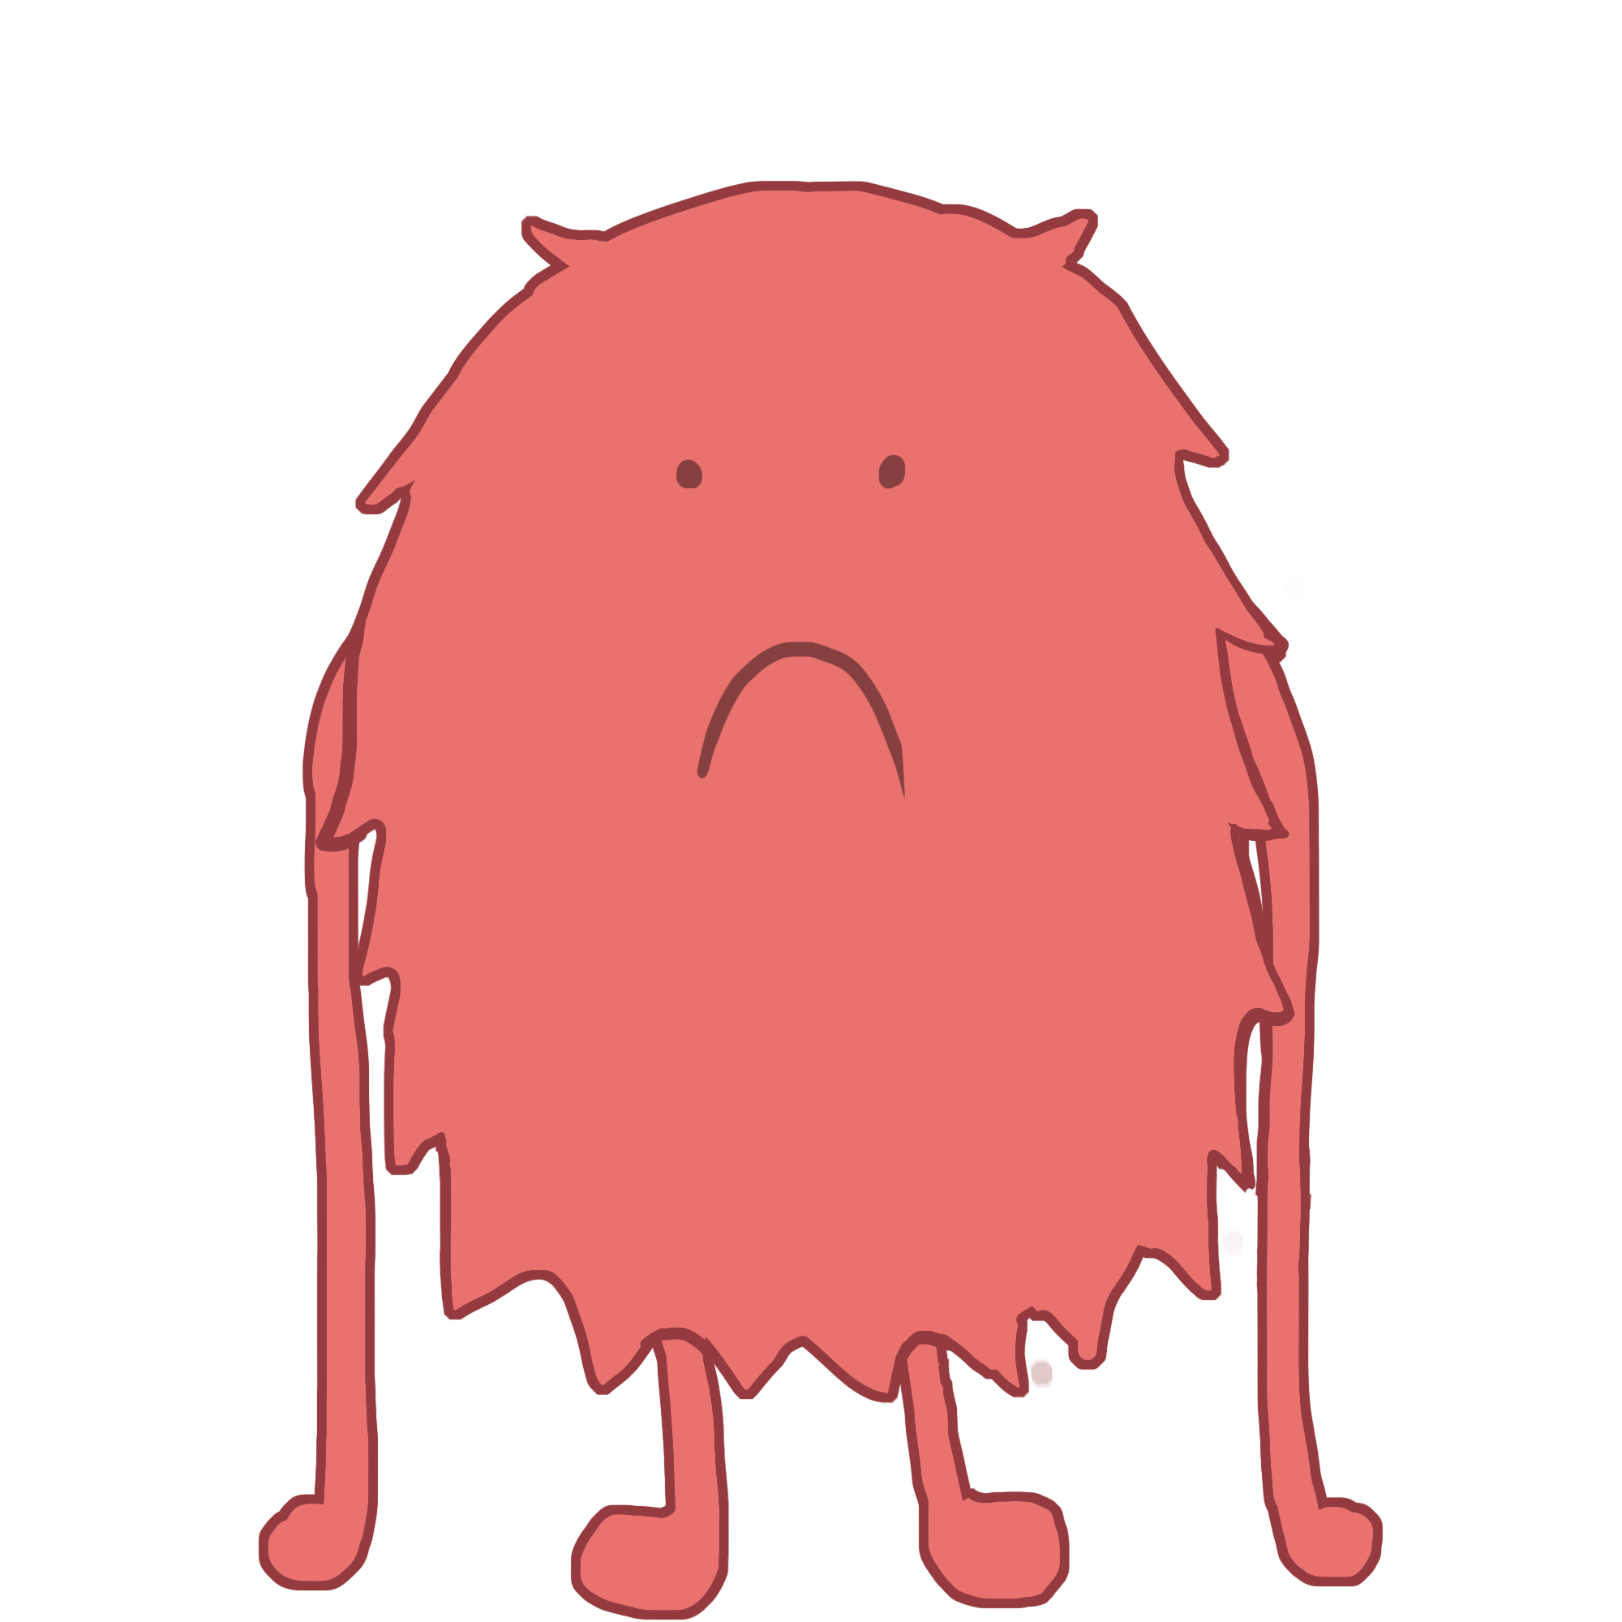
Slaying Dispassion
“I’m not excited about this anymore”

Slide 12
It’s usually meaningless
Everyone feels it at one point or another
Dispassion doesn’t mean your game is worthless
Dispassion doesn’t mean you’re lazy
Dispassion doesn’t mean that-new-idea-you-got-in-the-shower is better than your current project

Slide 13
The 2/5^{ths} Stage
Dispassion often hits hardest (at least for me) about 2/5 of the way into a project. Why?
The honeymoon phase of starting a new idea is over
You’re entering the awkward “Act 2” phase. You need to cut the overarching arch of your game into smaller pieces. This is just hard.
Recognizing this stage for what it is can help
Things will get better. You just have to push through this stage. AND YOU CAN DO IT!

Slide 14
The 5/5^{ths} Stage
The last stage of development is also very difficult. Why?
Scope creep. You’re so close to finished but you keep wanting to add more! Nope. Remember how to slay this.
Bugs, bugs, bugs. Suddenly all of your game development time has become bug testing. This is frustrating and not fun.
Marketing. Now that you’re almost ready to release your game, you’re thinking a LOT about marketing. This requires a lot of time and energy.
Once again, you just need to know this stage is difficult. But it also means you’re almost DONE. So STAY STRONG!

Slide 15
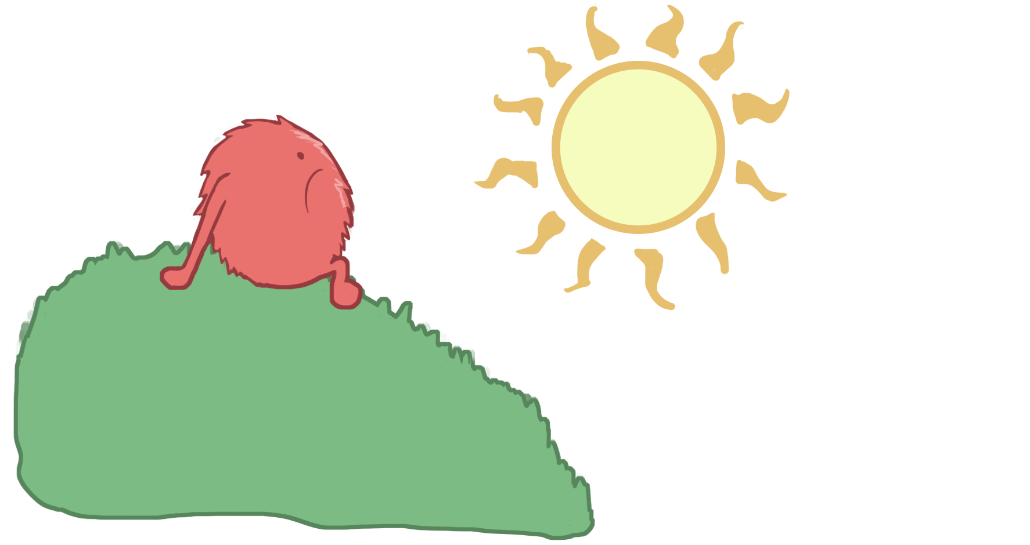
But what If there’s a reason?
If your dispassion continues for a very long time or keeps coming back repeatedly, only THEN you should examine it
Are you working on an unnecessary element of the game? If so, CUT it!
If you’ve been forcing yourself to work too much, take a break
Do other things you consider fun (such as playing similar games) and this will feed your inspiration
If you’re truly not happy and you’re not in stage 2 or 5, maybe change projects

Slide 16
Slaying PERFECTIONISM
“My game isn’t good enough”

Slide 17
Perfection is impossible
You will never catch all the bugs
You’ll always see things you wish you could improve
You’ll never make everyone happy
And that’s okay!

Slide 18
Learn from mistakes
Don’t let your fear of making mistakes paralyze you.
You WILL make mistakes. That’s part of the process.
In some games, the little mistakes add to their charm
Learning from your mistakes is how you’ll get better

